Slide 1
Employee Data Analysis using Excel
STUDENT NAME: KRISHNAVENI.D
REGISTER NO: 312208959,
NM id:C832D1358F79AF2AE594C8908EC4A41C
DEPARTMENT: B.COM GENERAL
COLLEGE: C.T.T.E COLLEGE FOR WOMEN

Slide 2
Project title:
Employee Performance Analysis using Excel

Slide 3


AGENDA
Problem Statement
Project Overview
End Users
Our Solution and Proposition
Dataset Description
Modelling Approach
Results and Discussion
Conclusion
3/21/2024 Annual Review

Slide 4

Problem statement: The employee performance analysis is been made to analyse the employees statements and to find the best employee to support them to do more and provide incentive for their hardwork .It helps to find out the overall performance and make some changes and improve their field work related to their source. It provides a detailed information to gathered in any source.
To address these issues, the organization needs a structured approach to systematically collect, analyze, and interpret employee performance data. This analysis will aim to provide clear insights into performance trends, ensure consistency in evaluations, and align employee contributions with organizational goals, ultimately leading to improved productivity and employee engagement.

Slide 5

Project overview:
The Employee Data Performance Analysis project aims to enhance organizational efficiency by evaluating and improving employee performance through data-driven insights. The primary objective is to systematically analyze performance data collected from various sources, including performance score, level and the average eligibility areas for improvement. This project involves defining quantitative and qualitative data, and applying analytical methods to uncover patterns and insights. The findings will be compiled into comprehensive reports, which will outline actionable recommendations for performance improvement, such as targeted training programs or process optimizations. An implementation plan will follow, designed to apply these recommendations and measure their effectiveness. By data analysis, the project aims to align employee performance with organizational goals, enhance productivity, and foster a more engaged and effective workforce.

Slide 6

Who are the end user:
1.Human Resources (HR) Department: HR professionals use performance analysis to make informed decisions about promotions, compensation, and development plans. They also use the data to design and implement training programs and to ensure fair and effective performance management practices.
2.Department Managers and Team Leaders: Managers and team leaders use performance analysis to evaluate the effectiveness of their teams, identify high performers, and address any performance issues. They also use the insights to provide targeted feedback, set goals, and allocate resources more effectively.
3.Executives and Senior Leadership: Executives and senior leaders use performance data to assess overall organizational performance, align employee contributions with strategic goals, and make decisions on resource allocation and strategic planning.
4.Employees: Employees are direct users of the feedback and development plans resulting from performance analysis. They benefit from clearer expectations, targeted training opportunities, and recognition of their achievements.
5.Training and Development Teams: These teams use performance data to tailor training programs to address specific skill gaps and to design interventions that improve overall employee performance and growth.

Slide 7
Our solution and its value proposition:
Confidential formatting – to mark the missing data , so that the data be highlighted to remove from the excel.
Filter – to remove the highlighted missing data and make it in a clear and neat format.
Formula – to calculate data for the performance level by the given performance score for the employee.
Pivot table – to provide summary for the data and to make it short and be brief to show the data.
Slicer – to make difference between the data and can select the particular data required.
Graph – to show overall data visualization and make it easier to view the information .

Slide 8
Dataset Description:
Employee database been downloaded from the Kaggle website and it contains the employees data in a set of 26 features and from that 9 features been selected for the data analysis. And the features were:
1. Employee id – numerical value.
2.Employee name – first and last name.
3. Business unit – type of work.
4.Employee status – active or future start.
5.Employee type – part time, full time, or contract.
6.Employee classification type – permanent or temporary.
7.Gender code – male and female.
8.Performance score - form 1 to 5.
9.Current employee rating – numerical values.

Slide 9

The "WOW“ in our solution:
The formula has been made to calculate the performance level by the information of performance score to classify the employee level as high, medium, low range.
=IFS(Z8>=5,"VERY HIGH",Z8>=4,"HIGH",Z8>=3,"MID",TRUE,"LOW")
3/21/2024 Annual Review
9

Slide 10
Modelling:
Data collection:
The data been downloaded for a website called as Kaggle which provide a wide range of data analysis
Form that download a particular data for the employee performance analysis.
It is been in an excel format to make it easier to evaluate the date in it.
Feature collection:
It is required to select or highlight a particular data for our basis
Out of 26 features selected only 9 features:
1. Employee id – numerical value.
2.Employee name – first and last name.
3. Business unit – type of work.
4.Employee status – active or future start.
5.Employee type – part time, full time, or contract.
6.Employee classification type – permanent or temporary.
7.Gender code – male and female.
8.Performance score - form 1 to 5.
9.Current employee rating – numerical values.
10

Slide 11
Data cleaning:
To remove the missing data select the data and highlight it by the confidential formatting and put filter to remove the blank space in the data.
As it makes look clear and help to select the data without any problem.
Performance level:
A formula been provided to calculate the performance level by the performance score of the employee.
Formula:
=IFS(Z8>=5,"VERY HIGH",Z8>=4,"HIGH",Z8>=3,"MID",TRUE,"LOW")
Summary:
From the data been selected a pivot table need to be placed in sheet 2, that is the next page of the excel.
It is made to have a detailed and a compact information of data for the overview of the data in a clear manner.
Followed by the slice for the difference of the employee status and types of the data and also for the gender code.

Slide 12
Visualization:
A graph been provided to visualize the data for more details and check the high, medium, low level of employee.
It is been made through the pivot table and by the recommended chart for the data suited.
And include the title for the graph, put terminal line for the high and low level of the graph data.

Slide 13
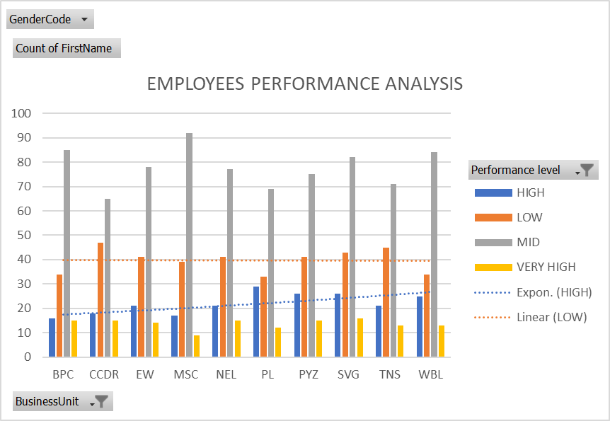
Result:
13

Slide 14
Conclusion:
The performance analysis highlights several key aspects of employee effectiveness and areas for growth within the organization. The evaluation indicates that the majority of employees are meeting or exceeding performance expectations, demonstrating strong commitment, skill proficiency, and alignment with organizational goals. Notable achievements include [specific achievements or strengths], which underscore the value these employees bring to their roles.
However, the analysis also identifies areas where improvements are needed. Specifically, the performance score, which present opportunities for targeted development and support. Addressing these areas through this process will be crucial in enhancing overall performance and achieving organizational objectives.

